Slide 1


Project name
Bank Loan Analysis
Group-5
Presented By –
Anuja Guwalani
shyam singh
Joshua denis
Santosh kumbhar
Sneha Chavre
Ruchika vaidya

Slide 2
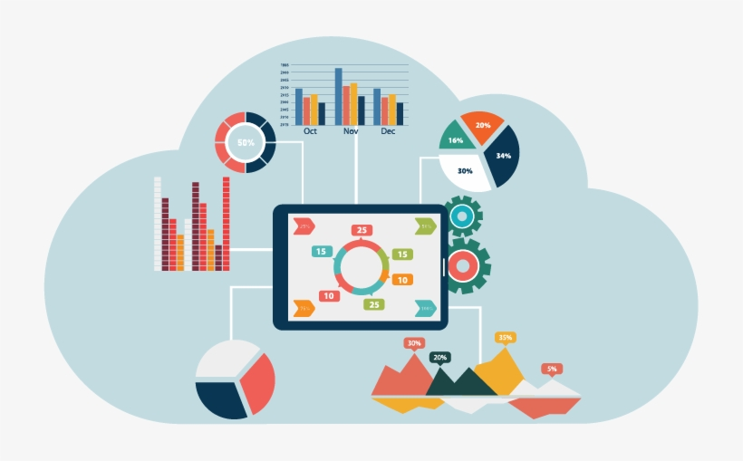
Project Objective
This is Bank loan analysis project where we were provided with 2 datasets with having 39717 rows each and the objective was to analyze the growth of that bank got within given years in loans.
We used MS-Excel, MySQL for analyzing, cleaning and removing duplicates from dataset and prepared dashboard using Tableau and Power BI tools where we did calculations, merging and prepared interactive dashboards.

Slide 3
Contents
KPI-1 : Year wise loan amount Stats
KPI-2 : Grade and sub grade wise revolve_balance
KPI-3 : Total Payment for Verified Status Vs Total Payment for Non Verified Status
KPI-4 : State wise and last_credit_pull_dept wise loan status
KPI-5 : Home ownership Vs last payment date stats

Slide 4
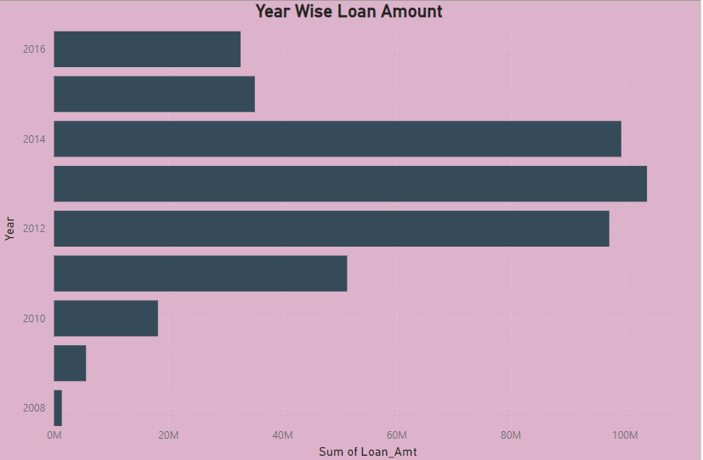
KPI-1 Year Wise Loan Amount
In this chart interest rate and dept installments both are increasing year by year.
As interest rates move up, the cost of borrowing becomes more expensive.
﻿Sum of Loan Amount trended up, resulting in a 2,291.46% increase between 2008 and 2016.
﻿Sum of Loan Amount started trending up on 2008, rising by 3,656.83% (49991675) in 3 years.
﻿Sum of Loan Amount jumped from 1367075 to 51358750 during its steepest incline between 2008 and 2011.

Slide 5
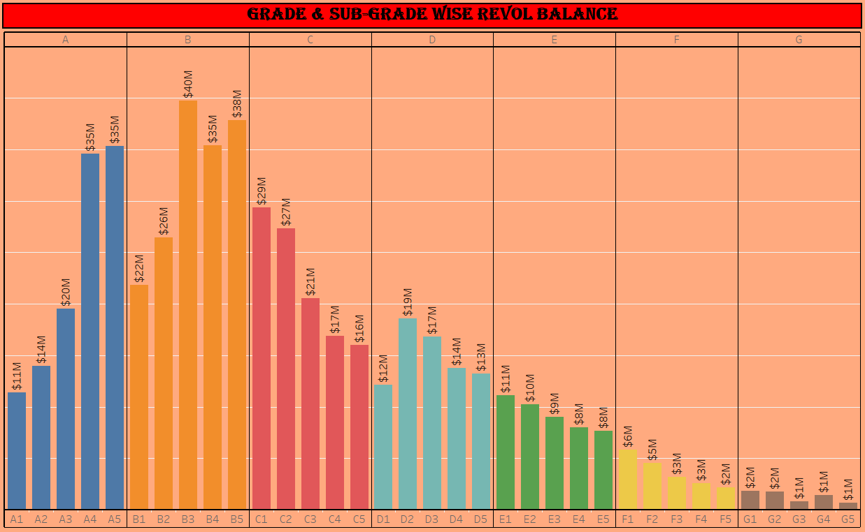
KPI-2 Grade and Sub Grade Wise Revolve Balance
In this Grade and subgrade wise revolve balance we can notice Grade-B have more revol balance then any other grade & Grade-G have very low revolve balance.
As we can see that Grade B customers has higher annual income for 10+ yrs of employment period, so higher the annual income lower the Debt to income ratio and hence, more number of customers took loan in Grade B .
Similary, it goes for other grades also B>A>C>D>E>F>G order for revolving balance as per annual income.

Slide 6
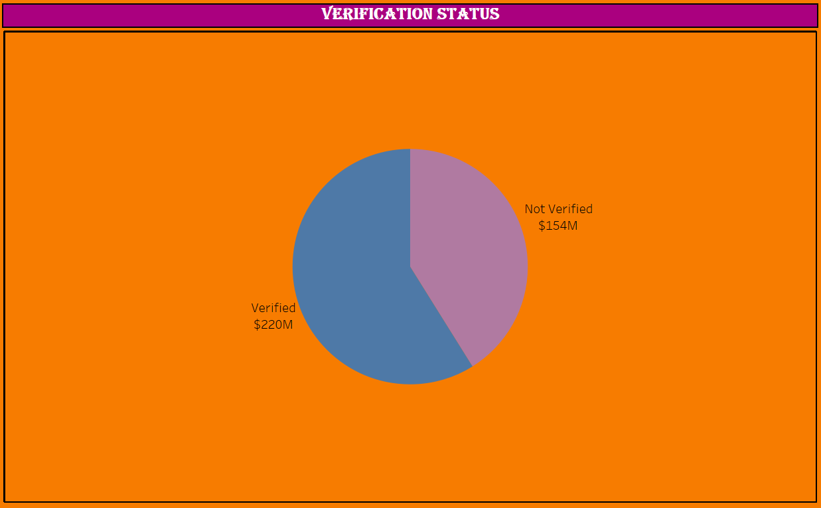
KPI-3 Total Payment For Verified & Non-Verified Status
This is the first stage of the verification process. The bank needs a loan application to initiate the document collection and verification process.
Looking at pie chart we can observe that verified status have 58.88% of total payment and 41.12% of total payment which are Not Verified for the Loan Amount.
Sum of Total payment for Verified (21,98,92,307.51) was higher than Not Verified (15,35,41,418.21).﻿

Slide 7
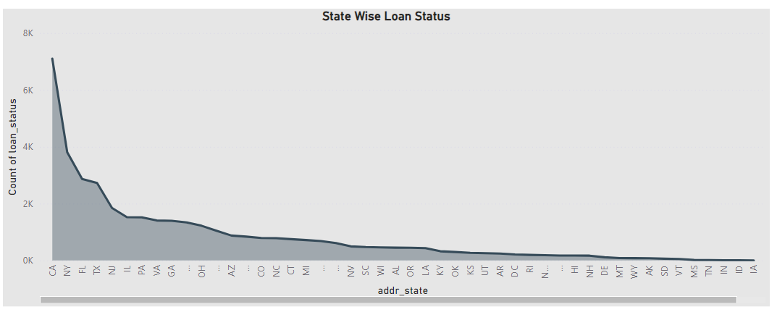
KPI-4 State Wise Loan Status
The right graph shows the count of Loan Status in each state of USA on particular last credit pull date.
As we can see CA had the highest Count of loan status and was 7099 higher than followed by NY and FL.
ME had the lowest Count of loan status at 3.
Across all 50 address state, Count of loan status ranged from 3 to 7,099.
This clearly shows that 97% of bank customers have fully paid status for each state.

Slide 8
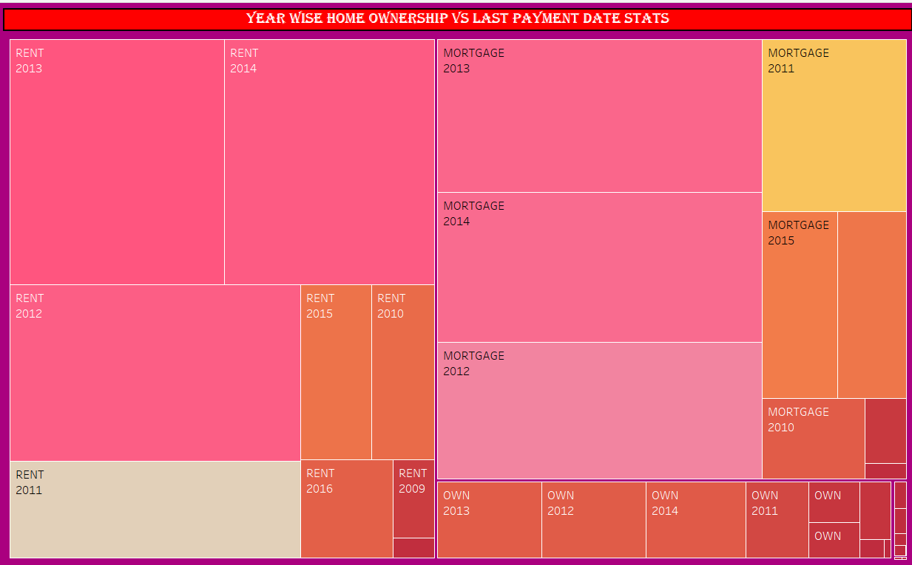
KPI-5 Home ownership Vs last payment date stats
The right graph shows the Home ownership and the amount paid for each on last payment date.
Here, we can see that maximum latest amount paid by customers with MORTGAGE &RENT home ownership.
It concludes that many of the customers are about to repay their loan amount for their particular home ownership.

Slide 9
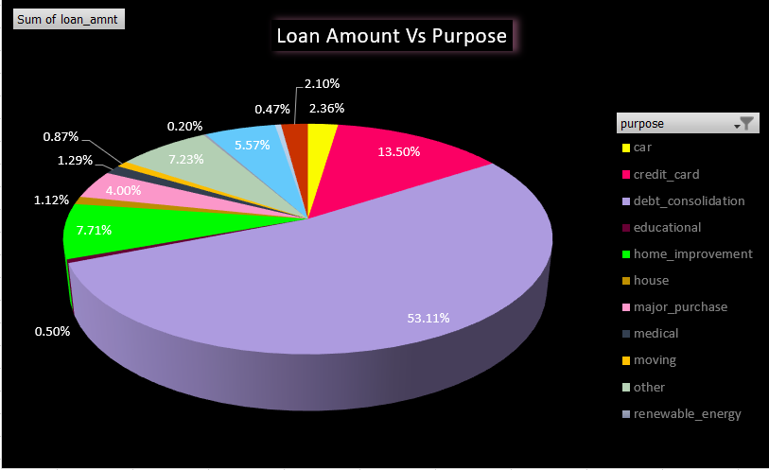
Loan Amount Vs purpose

Slide 10
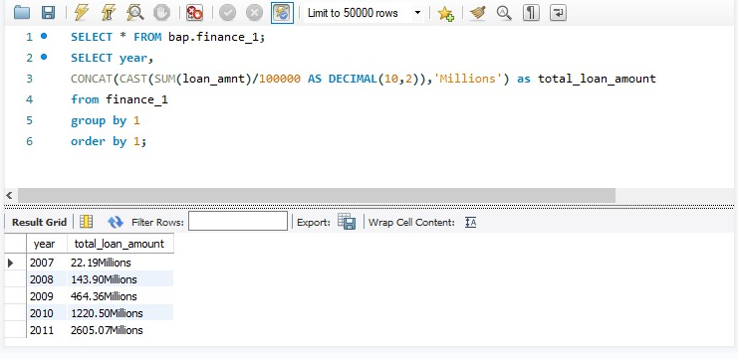
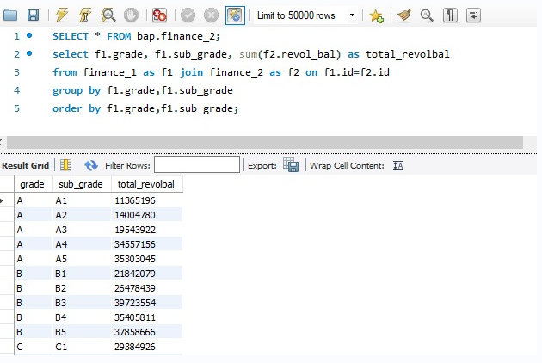
KPI-1 Year Wise Loan Amount
KPI-2 Grade and Sub Grade Wise Revolve Balance

Slide 11
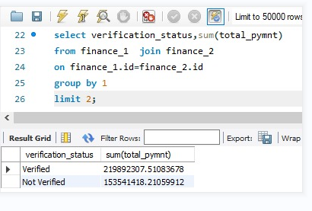
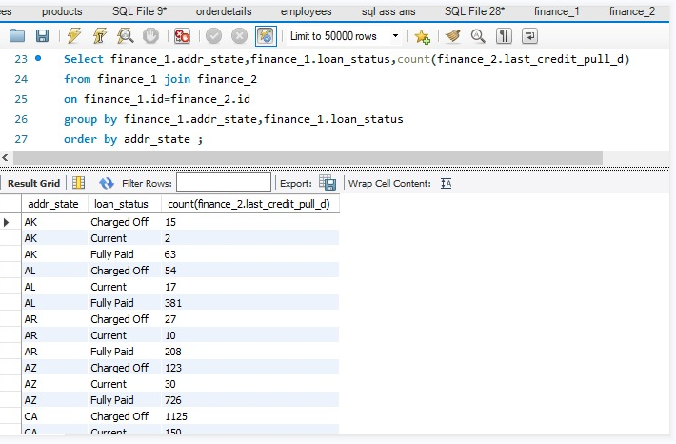
KPI-3 Verified & Non-Verified Status
KPI-4 State Wise Loan Status

Slide 12
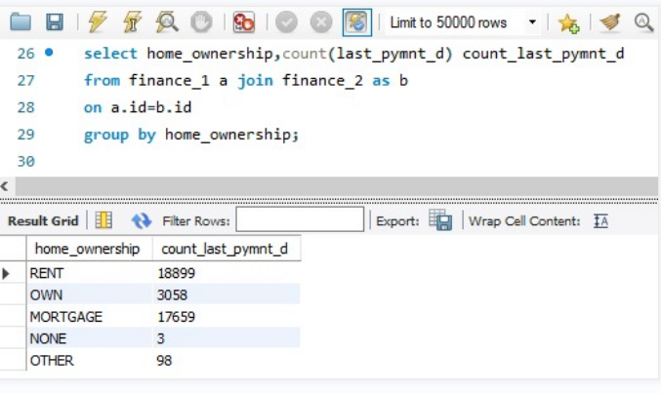
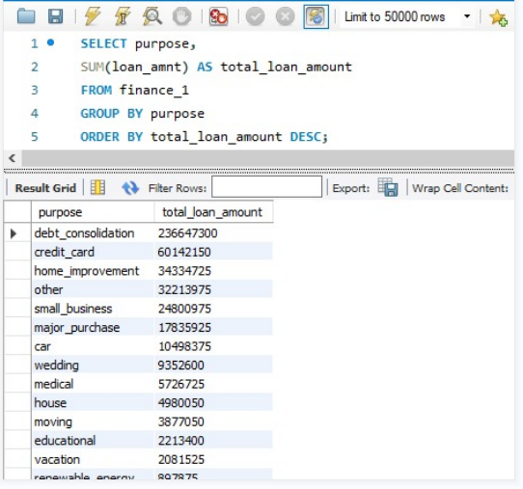
KPI-5 Home ownership Vs last payment date stats
Loan Amount VS purpose

Slide 13
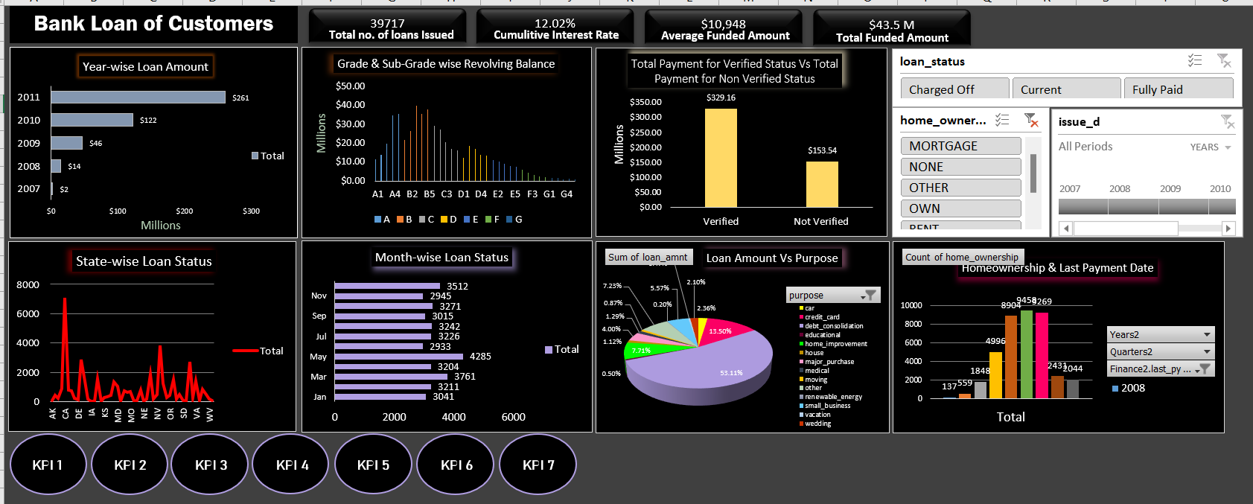
Excel Dashboard

Slide 14
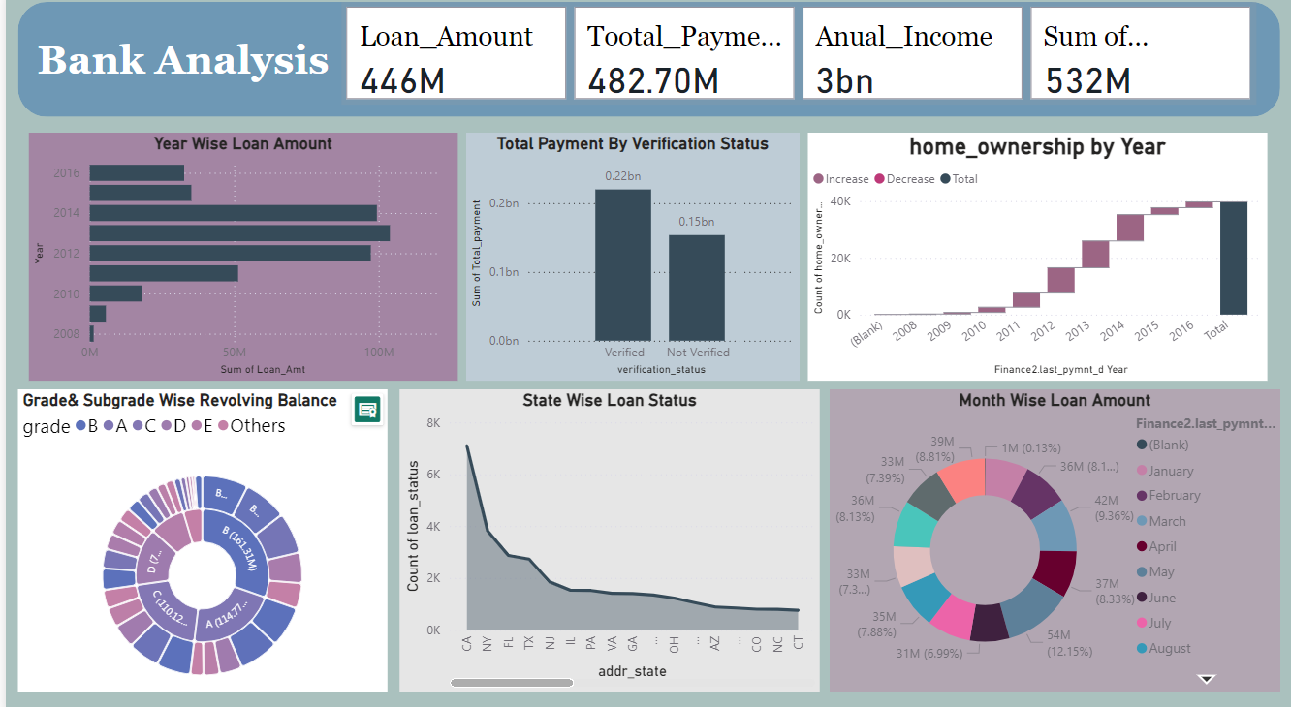
Power Bi Dashboard

Slide 15
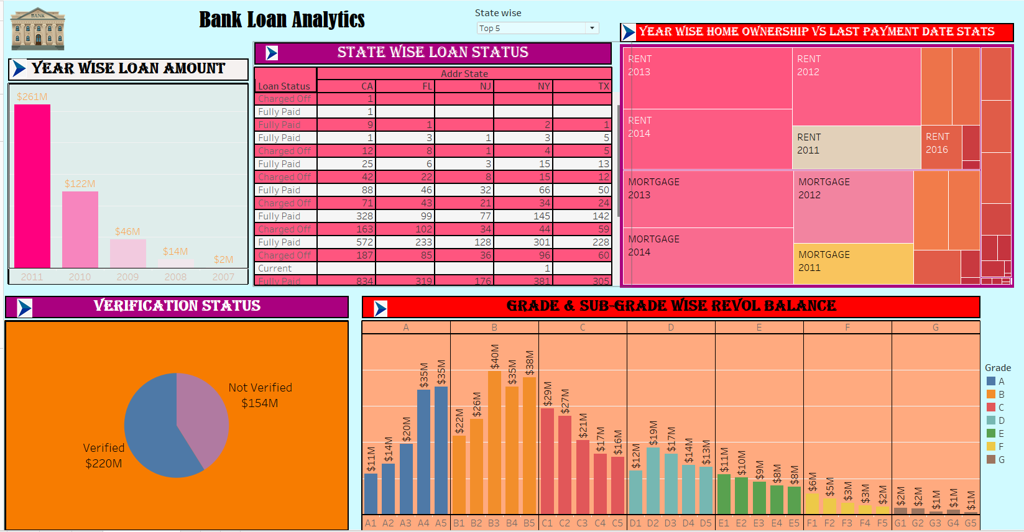
Tableau Dashboard

Slide 16
Thank you

